Slide 1
“LOADER AND LINKER”

Slide 2
CONTENTS :-
Introduction, Loader schemes:
Compile and Go
General Loader Scheme
Absolute Loaders
Subroutine Linkages
Relocating Loaders
Direct linking Loaders
Overlay structure,
Design of an Absolute Loader,
Design of Direct linking Loader,
Self-relocating programs,
Static and Dynamic linking

Slide 3
CONTENTS :-
Sample videos :
Preprocessor :
https://youtu.be/JZkPEl8JjZo?list=PLhb7SOmGNUc6Fg7zmBOOS3 yN2AG0JiREp
Compiler execution stages :
https://youtu.be/cJDRShqtTbk?list=PLhb7SOmGNUc6Fg7zmBOOS 3yN2AG0JiREp

Slide 4
Introduction
Computer : A programmable device that can store, retrieve, and process data.(Combination of H/w & S/w )
Hardware : things which we can touch.
Software : things which we cannt touch.(Can only see)
Programming: A programming language is a set of commands, instructions, and other syntax use to create a software program.
Data : Information in a form a computer can use
Information : Any knowledge that can be communicated

Slide 5
Introduction
Machine language : The language, made up of binary coded instructions, that is used directly by the computer
Assembly language : A low-level programming language in which a mnemonic is used to represent each of the machine language instructions for a particular computer

Slide 6
Introduction
Source code : Program or set of instructions written in a high-level programming language
Object code : A machine language version of source code.
Target code : program output in Machine code (binary form)
,

Slide 7
Introduction
Preprocessor :
A preprocessor is a program that processes its input data to produce output that is used as input to another program.
Editor : A text editor is a type of computer program that edits plain text. Such programs are sometimes known as "notepad" software
Compiler : A program that translates a program written in a high- level language into machine code
Assembler : A program that translates an assembly language program into machine code

Slide 8
Introduction
Loader:-
A loader is a program used by an operating system to load programs from a secondary to main memory so as to be executed.
Linker :
A linker is a computer program that takes one or more object files generated by a compiler and combines them into one, executable program
Debugger :
Debugger is program which is used to test program or execute program in single step execution.

Slide 9

INTRODUCTION TO LOADER
Object code, or an object file, is the representation of code that a compiler or assembler generates by processing a source code file.
A linker is typically used to generate an executable file by linking object files together.
Object files often also contain data for use by the code at runtime, relocation information, program symbols (names of variables and functions) for linking and/or debugging purposes, and other debugging information.

Slide 10




Introduction
to
Loader

Slide 11
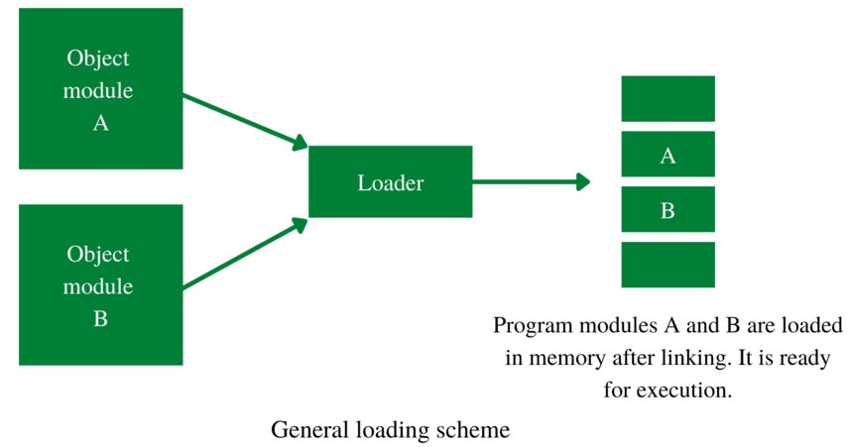
INTRODUCTION TO LOADER
The loader loads the program into the main memory for execution of that program. It loads machine instruction and data of related programs and subroutines into the main memory, this process is known as loading. The loader performs loading; hence, the assembler must provide the loader with the object program

Slide 12

FUNCTION OF LOADER
Allocation: It allocates memory for the program in the main memory.
Linking: It combines two or more separate object programs or modules and supplies necessary information.
Relocation: It modifies the object program so that it can be loaded at an address different from the location.
Loading: It brings the object program into the main memory for execution.

Slide 13

Source Program
Loader
Object program ready for execution
Assembler
Fig.: Role of loader
Memory
10/28/2023

Slide 14
Loader is utility program which takes object code as input prepares it for execution and loads the executable code into the memory.
Thus loader is actually responsible for initiating the executions process.
10/28/2023

Slide 15
Relocation and linking concepts
10/28/2023

Slide 16

User defined function and library function
Example - printf() ,scanf()
The linking process makes address of modules known to each other so that transfer of control takes place during execution.
Passing of parameter is handled by the linker.
Public variable-same address
External variable –defined in one module and used in another module.
Resolving of addresses of symbolic reference is handled by the linker.
10/28/2023

Slide 17

Linker-
Handled the passing of parameter 2.Resolving of address of symbolic reference
10/28/2023

Slide 18

It is the process of modifying the addresses used in the address sensitive instructions of a program
So, program Can execute correctly from any designated area of memory.
Ex. MOVER AREG,X
Ex.:-Program A, call function F1();
Program A and F1() must be linked with each _{o}10_{t}/2_{h}8/2_{e}023_{r.}
18

Slide 19

Case I: Address assigned to Prog. A and F1 () when they translated to
memory
0
Drawback- a lot of storage area is wasted
100
A
250
Wasted area
400
F1
500
Fig.: General Loading scheme
10/28/2023
19

Slide 20

Case II: These two module cannot co-exist at same storage locations.
Main Storage
0
A
100
A
150
250
151
F1
100
251
F1
200
Relocated address given by the loader
Translation time address
10/28/2023
Fig.: Relocation to avoid address conflict or storage waste
20

Slide 21

A loader must relocate A and F1 to avoid address conflict or storage waste.
Relocation refers to adjustment of address field
not to movement of a program.
10/28/2023
21

Slide 22

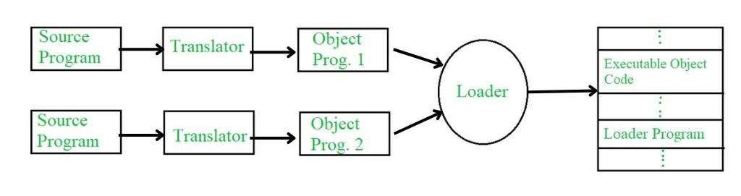
ARCHITECTURE OF LOADER
Architecture of Loader

Slide 23
ARCHITECTURE OF LOADER
Source program: This is a program written in a high-level programming language that needs to be executed.
Translator: This component, such as a compiler or interpreter, converts the source program into an object program.
Object program: This is the program in a machine-readable form, usually in binary, that contains both the instructions and data of the program.
Executable object code: This is the object program that has been processed by the loader and is ready to be executed.

Slide 24

ADVANTAGES OF LOADER
Memory management – allow separate/protected area
Dynamic Linking – handle external references
Relocation – to avoid conflict with other program
Error handling – missing libraries, incompatible instruction
Modularity – easier to maintain and update
Reusability – same module/libraries can be used by other program also

Slide 25

DISADVANTAGES OF LOADER
Complexity – implementation difficult due to memory management, relocation etc.
Overhead – take more time to process
Limited flexibility – may not be easily portable
Security – poor design may introduce vulnerability
Dependency issues – may depend on external libraries

Slide 26




Slide 27

Various types of loader ,based on various functionalities
Compile and go loader
General loader scheme
Absolute loader
Subroutine linkage
Relocating loader
Direct linking loader
10/28/2023
27

Slide 28
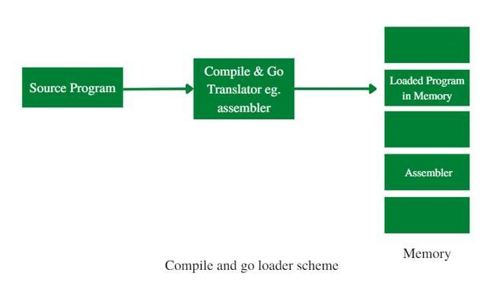
COMPILE AND GO LOADER
Compile and Go Loader :

Slide 29

COMPILE AND GO LOADER
Performing the loader function is to have the assembler run in one part of memory and place the assembled machine instructions and data, as they are assembled, directly into their assigned memory location. It is also called “assemble and go loader”
In this scheme, the source code goes into the translator line by line, and then that single line of code loads into memory.
In another language, chunks of source code go into execution. Line-by- line code goes to the translator so there is no proper object code. Because of that, if the user runs the same source program, every line of code will again be translated by a translator. So here re-translation happens.

Slide 30

ADVANTAGES COMPILE AND GO LOADER
It is very simple to implement.
The translator is enough to do the task, no subroutines are needed.
It is the most simple scheme of the functions of the loader
It provides security
Disadvantages:
There is no use of the assembler but it is still there so a wastage of memory takes place.
When source code runs multiple times the translation is also done every time. so re-translation is happening.
Difficult to produce an orderly modular program
Difficult to handle multiple segments like if the source program is in a different language. eg. one subroutine is assembly language & another subroutine is FORTRAN

Slide 31

GENERAL LOADER SCHEME
General Loader Scheme :
In this loader scheme, the source program is converted to object program by some translator (assembler). The loader accepts these object modules and puts the machine instruction and data in an executable form at their assigned memory. The loader occupies the same portion of main memory.

Slide 32
Program modules A and B are loaded in memory after linking. It is ready for execution
Object Module
A
A
Loader
B
Object Module
B
10/28/2023
Fig.: General Loading scheme
32

Slide 33

GENERAL LOADER SCEMES
Architecture of Loader

Slide 34

GENERAL LOADER SCEMES
Source program: This is a program written in a high-level programming language that needs to be executed.
Translator: This component, such as a compiler or interpreter, converts the source program into an object program.
Object program: This is the program in a machine-readable form, usually in binary, that contains both the instructions and data of the program.
Executable object code: This is the object program that has been processed by the loader and is ready to be executed.

Slide 35

ADVANTAGES OF GENERAL LOADER
Smaller than Assembler
No reassembly is needed
Possible to write subroutines in different languages
There is no wastage of memory because assembler is not placed in memory so more memory is available to user.
Avoid drawbacks of Compile and Go Loader.

Slide 36

DISADVANTAGES OF GENERAL LOADER
Some portion of memory occupied by loader
General loader cannot handle different object model from other computer.
Dependenacy issues

Slide 37

ABSOLUTE LOADER
Absolute Loader: It loads a program at a specific memory location, specified in the program’s object code. This location is usually absolute and does not change when the program is loaded into memory.
An Absolute loader is the simplest of all other loaders.
It takes the output of Assembler and load into memory without relocation.
The output of the assembler can be stored on any machine readable form of storage, But most commonly it is stored on punched cards or magnetic tape, disk, or drum.
It loads a binary program in memory for Execution .

Slide 38

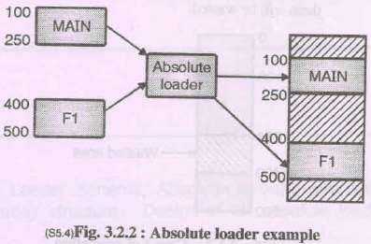
10/28/2023

Slide 39

Binary program is stored in a file that contains:
Header records: Contains load Origin ,Length of code, load time execution starting address of program.
Transfer record: contains entry point of execution
10/28/2023

Slide 40


ADVANTAGES OF ABSOLUTE LOADER
It is simple to implement
No relocation is required.
The process of execution is efficient.
The task of loader becomes simpler as it simply obeys the instruction regarding where to place the object code to the main memory.
This scheme allows multiple programs or the source programs written in different languages.

Slide 41


DISADVANTAGES OF ABSOLUTE LOADER
Programmer must specify the starting address to the assembler for the program where it should be loaded.
so programmer must know memory management as well as memory status at any time.
It is very difficult to relocate in case of multiple subroutine.

Slide 42
In absolute loader 4 loader function are performed by,
Allocation: by programmer
Linking: by programmer
Relocation: by assembler
Loading-by loader
10/28/2023
43

Slide 43

SUBROUTINE LINKAGE LOADER
Subroutine: In given program ,it is often needed to perform a particular subtask many times on different data values. such a subtask is usually called a subroutine.
Subroutine linkage method: The way in which a machine makes it possible to call and return from subroutine is referred to as its Subroutine linkage method

Slide 44
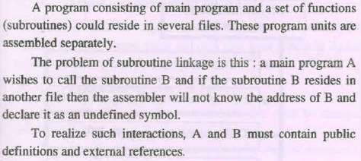
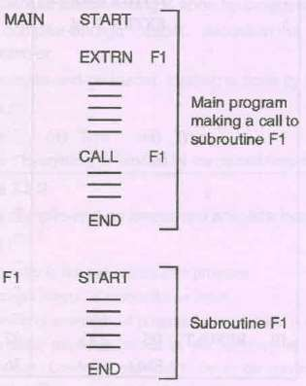
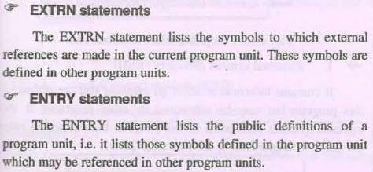
4. SUBROUTINE LINKAGE

Slide 45


ADVANTAGES OF SUBROUTINE LINKAGE
Code reuse: Subroutines can be reused in multiple parts of a program, which can save time and reduce the amount of code that needs to be written.
Modularity: Subroutines help to break complex programs into smaller, more manageable parts, making them easier to understand, maintain, and modify.
Encapsulation: Subroutines provide a way to encapsulate functionality, hiding the implementation details from other parts of the program.

Slide 46

DISADVANTAGES OF SUBROUTINE LINKAGE
Overhead: Calling a subroutine can incur some overhead, such as the time and memory required to push and pop data on the stack.
Complexity: Subroutine nesting can make programs more complex and difficult to understand, particularly if the nesting is deep or the control flow is complicated.
Side Effects: Subroutines can have unintended side effects, such as modifying global variables or changing the state of the program, which can make debugging and testing more difficult.

Slide 47

RELOCATING LOADER
A relocating loader is a type of loader that is used in system software to load programs into memory and adjust their addresses. It is responsible for dynamic loading, address translation, and using a symbol table to adjust the addresses of a program's instructions and data.

Slide 48
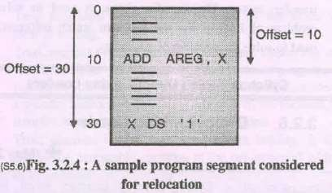
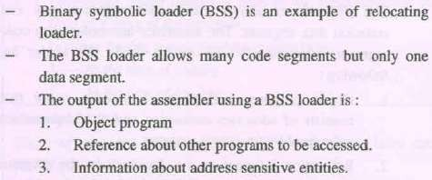
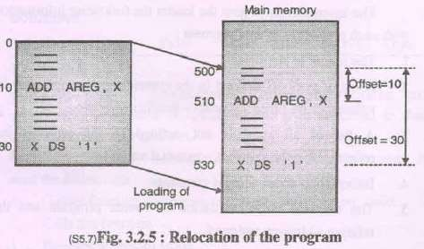
5. RELOCATING LOADER

Slide 49

5. RELOCATING LOADER
Relocation is the process of modifying the address used by program such that program can execute correctly.
E.g. assume that a program A calls a function F1. The program A and the function F1 must be linked with each other. But where we have to load in main storage? A possible solution would be to load them according to address assigned when they were translated.
Case (I) At the time of translation A has been given storage area from 100 to 250 while F occupies area between 400 to 500. If we were to load these programs at their translated address , a lot of storage will be wasted.

Slide 50
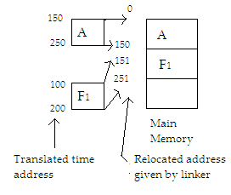
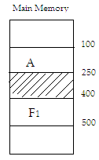
5. RELOCATING LOADER
Case (II) at the time of translated, both A and F1 may have been translated with the identical start address 100. A goes from 100 to 250 and F1 goes from 100 to 200. These two modules cannot co-exist at same. The linker must relocate A and F1 to avoid address conflict or storage waste A possible relocation is shown in figure.
It may be noted that relocation more than simply moving a program from one are to another in the storage. It refers to adjustment of address fields and not to movement of a program.

Slide 51
It avoid reassembling of all subroutines when single subroutine change.
All 4 function are performed (i.e. Allocation, Loading, Linking & reallocation).
Transfer vector is used to solve the problem of linking & Program length info to solve allocation.
10/28/2023

Slide 52
No suited for loading external data.
Transfer vector increase the size.
Does not facilitate access to data segment that can be shared.
10/28/2023

Slide 53
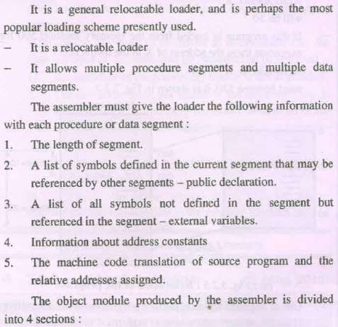
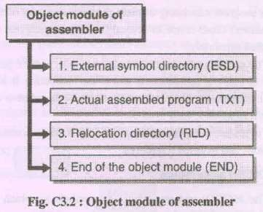
6. DIRECT LINKING LOADER

Slide 54
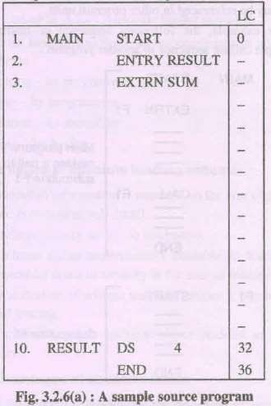
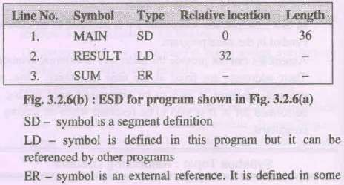

Slide 55

It is type of Re-locatable Loader.
It is most common type of loader.
It allows the programmer to use multiple procedure segments and multiple data segments.
The assembler should give the following information to the loader:
The length of the object code segment.
A list of all symbols which are not defined in the current segment but can be used in the current segment.
10/28/2023

Slide 56
A list of all symbols which are defined in the current segment but can be referred in the current segment.
Information about address constants.
Machine code translation of the source program and relative address.
To place the object code in the memory there are two situations:1. Address of the object code could be absolute.2. The address of object code can be relative.
10/28/2023

Slide 57

The list of symbols not defined in the current segment but used in the current segment are stored in a data structure called USE table.
The lists of symbols defined in the current segment and referred by the other segments are stored in a data structure called DEFINITION table.
10/28/2023

Slide 58
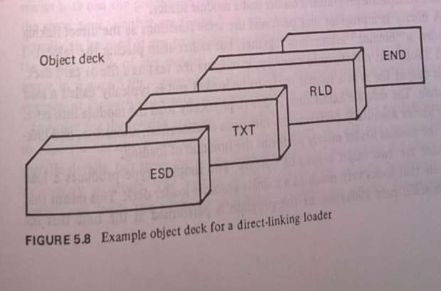
Assembler generates 4 types of cards in the object desk:
ESD:External Symbol Dictionary (ESD) record:
TXT: (TXT) records.
RLD: Relocation and Linkage Directory (RLD):
END :End of object deck
10/28/2023
59

Slide 59
1.ESD:External Symbol Dictionary (ESD) record:
Card contain information about all symbol that are defined in this program, but that may reference elsewhere, and all symbol referenced in this program but defined elsewhere.
Source object record no./card no. | symbol | Type | Relative Location | Length
1 | MAIN | SD | 0 | 36
2 | RESULT | LD | 32 | -
³ 10/28/2023 | SUM | ER | - | ⁻ 60

Slide 60
Type:
SD: segment definition: symbol in segment
LD: Local definition: symbol is defined in this program but it can be referenced by other program.
ER: External symbol: defined in some external program.
10/28/2023

Slide 61
2. TXT: (TEXT) records.
Text card contains actual object code.(translated source code).
Source object record no. | Relative Location | Object code
1 | 0
2 | 32
3 | -
10/28/2023

Slide 62
3. RLD: Relocation and Linkage Directory (RLD):
Card contain information about those locations in the program whose content depend on the address at which the program is placed
Source object record no. | ESD_ID | Length(in Byte) | Flag + or - | Relative address
+ sign denote that something must be added to the constant

Slide 63
4.END: card indicate the end of object code and specifies the starting address for execution if assembled routine is the main program.
10/28/2023

Slide 64
Allow multiple procedure and data segment.
Allow independent translation of the program.
Relocation Facility.
10/28/2023

Slide 65
Not suitable in multitasking.
It is necessary to allocate, relocate, link, and load all of the subroutines each time in order to execute a program
loading process can be extremely time consuming.
10/28/2023

Slide 66
Design of direct linking loader is more complicated than absolute loader.
Input to loader is object module and this is divide into 4 section ESD,TXT,RLD,END
It requires two passes to complete the linking process
Pass I: assigns addresses to all external symbols (Uses Global EST: GEST)
Pass II: performs actual loading, relocation and linking.
10/28/2023

Slide 67
In Pass I ,a Global External Symbol table(GEST) is prepared.
It contain every external symbol and corresponding absolute address value.
10/28/2023

Slide 68













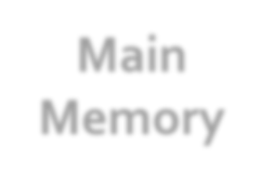




Copy of object records
Object Module
Pass I
Pass II
Main Memory
Object Module
GEST
10/28/2023

Slide 69

OVERLAY STRUCTURE
Overlays: The loader can load programs in chunks called overlays, which allows programs to run in a smaller memory space by only loading the needed parts of the program at a time.

Slide 70
OVERLAY STRUCTURE
Program execution need not be achieved by loading all the parts of large program in memory.
So,that we can reduce memory requirement of such program by loading required parts of program in memory.
Hence some parts of program are given the same load address during linking.
Therefore,at any time,only one of these parts of program can be loaded in memory because loading of other parts that has same load address will overwrite it.
10/28/2023
71

Slide 71
OVERLAY STRUCTURE
Overlay is a part of program that has same load origin as some
other parts of the program .and the program which contains overlays is called as overlay structured program.
It consist of Permanently resident portion known as ROOT.
Set of overlays that will be loaded in memory as per the requirements.
Overlay manager is linked with the root.
Root is loaded in memory .
10/28/2023
72

Slide 72
OVERLAY STRUCTURE
EXAMPLE
Suppose a program consisting of five subprograms (A{20k},B{20k}, C{30k}, D{10k}, and E{20k}) that require 100K bytes of core.
Subprogram A only calls B, D and E;
subprogram B only calls C and E;
subprogram D only calls E
subprogram C and E do not call any other routines
Note that procedures B and D are never in used the same time; neither are C and E.
10/28/2023
73

Slide 73
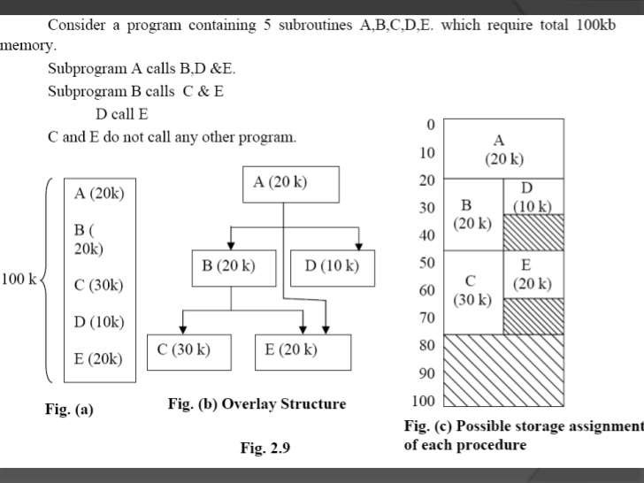
OVERLAY STRUCTURE
10/28/2023 74

Slide 74
ADVANTAGES OF OVERLAY STRUCTURE
Increased memory utilization: Overlays allow multiple programs to share the
same physical memory space, increasing memory utilization and reducing the need for additional memory.
Reduced load time: Only the necessary parts of a program are loaded into memory, reducing load time and increasing performance.
Improved reliability: Overlays reduce the risk of memory overflow, which can cause crashes or data loss.
Reduce memory requirement
5. Reduce time requirement
10/28/2023
75

Slide 75
DISADVANTAGES OF OVERLAY STRUCTURE
Complexity: Overlays can be complex to implement and manage, especially for large programs.
Performance overhead: The process of loading and unloading overlays can result in increased CPU and disk usage, which can slow down performance.
Compatibility issues: Overlays may not work on all hardware and software configurations, making it difficult to ensure compatibility across different systems.
Overlap map must be specified by programmer
Programmer must know memory requirement
Overlapped module must be completely disjoint
Programming design of overlays structure is complex and not possible in all cases
10/28/2023
76

Slide 76
What is linker? Why program relocation is required and how is it performed?
Any usable program written in any language has to use functions / subroutines. These functions could be either user defined functions or they can be library functions.
For example, consider a program written in C language such a program may contain calls to functions like printf( ). During program execution main program calls the function
The linking process makes address of modules known to each other so that transfer of control takes place.
Passing of parameters is handled by the linker.
An external variable can be defined in one module and can be used in another module.

Slide 77
SELF RELOCATING PROGRAM
Program relocatibility refers to the ability to load and execute a given program into an arbitrary place in memory as opposed to a fixed set of locations specified at program translation time depending on how and when the mapping from virtual address space to the physical address space takes place in given relocation:
(a) Static (b) Dynamic .
A self relocating program is a program which can perform the relocation itself. Self relocating program contain the relocating logic, so no need of a linker in that.

Slide 78
STATIC & DYNAMIC LINK LIBRARIES
1. Static Linking :
A static linker takes object files produced by the compiler including library functions and produces and executable file. The executable file contains a copy of every subroutine (user defined or library function.) The biggest disadvantage of the static linking is that each executable file contains its own copy of the library routines. If many programs containing same library routines are executed then memory is wasted.

Slide 79
STATIC & DYNAMIC LINK LIBRARIES
Dynamic Linking :
Dynamic linking defers much of the linking process until a program starts running. Dynamic linking involves the following steps:
A reference to an external module during run time causes the loader to find the target module and load it.
Perform relocation during run time
Dynamic linking permits a program to load and unload routines at run time.

Slide 80
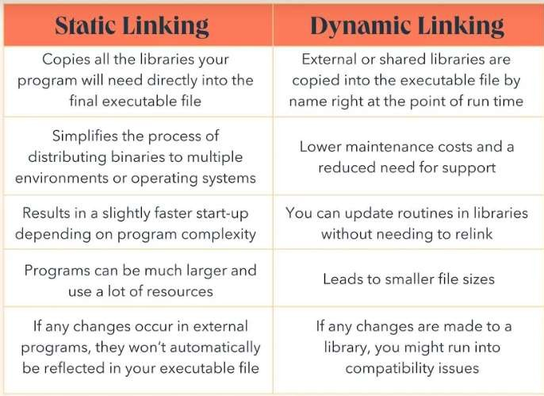
STATIC & DYNAMIC LINK LIBRARIES

Slide 81
LINKER VS LOADER
^{BASIS FOR} LINKER LOADER COMPARISON
Basic It generates the executable It loads the executable module to module of a source the main memory. program.
Input It takes as input, the object It takes executable module code generated by an generated by a linker. assembler.
Function It combines all the object It allocates the addresses to an modules of a source code to executable module in main generate an executable memory for execution. module.
Type/Approac Linkage Editor, Dynamic Absolute loading, Relocatable h linker. loading and Dynamic Run-time loading.

Slide 82
REFERENCES
https://www.geeksforgeeks.org/basic-functions-of-loader/
https://www.geeksforgeeks.org/loader-in-compiler-design/
https://www.geeksforgeeks.org/compiler-and-go-loader/
https://www.geeksforgeeks.org/subroutine-subroutine-nesting-and-stack- memory/
https://www.geeksforgeeks.org/overlays-in-memory-management/

